Slide 1
INTRODUCTION TO COMPUTING
Course Code: CCINCOM/L
Model Free Control
Elizer Ponio Jr.
Faculty Member
Department of Computer Science
College of Computing and Information Technologies (CCIT)
National University
Joseph Marvin R. Imperial
REINFORCEMENT LEARNING
NU College of Computing and Information Technologies
Course Code: CCRNFLRL

Slide 2
Outline
INTRODUCTION TO COMPUTING
Course Code: CCINCOM/L
Introduction
On-Policy and Off-Policy
ε-Greedy Exploration
On-Policy
GLIE Monte-Carlo
SARSA
Off-Policy
Q-Learning
Joseph Marvin R. Imperial
REINFORCEMENT LEARNING
NU College of Computing and Information Technologies
Course Code: CCRNFLRL

Slide 3
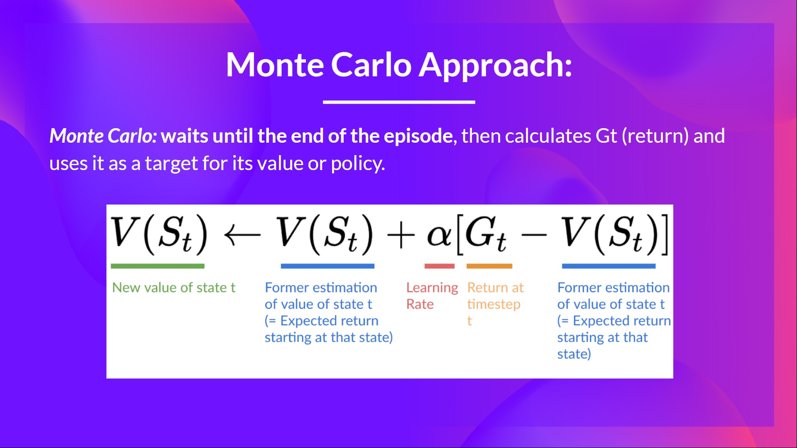
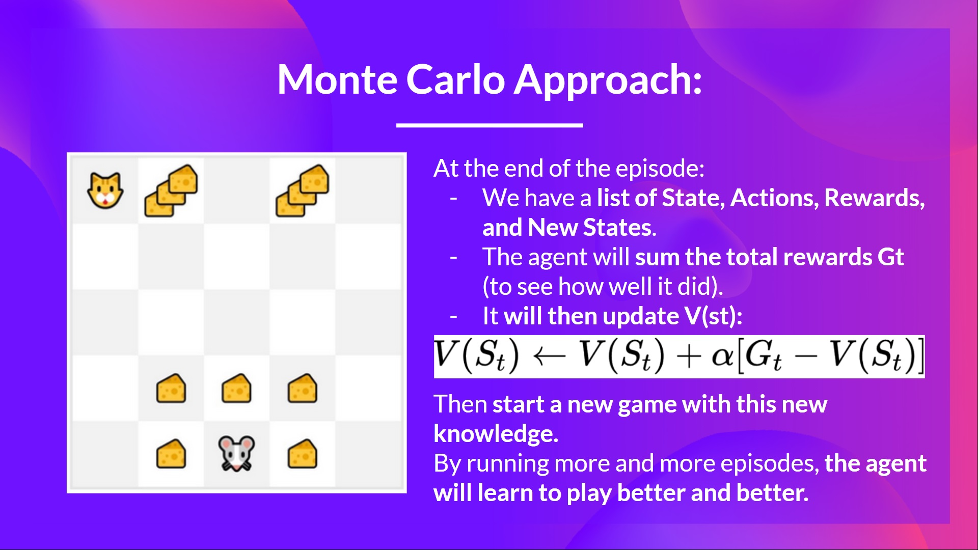
Refresher
INTRODUCTION TO COMPUTING
Course Code: CCINCOM/L
Joseph Marvin R. Imperial
REINFORCEMENT LEARNING
NU College of Computing and Information Technologies
Course Code: CCRNFLRL

Slide 4
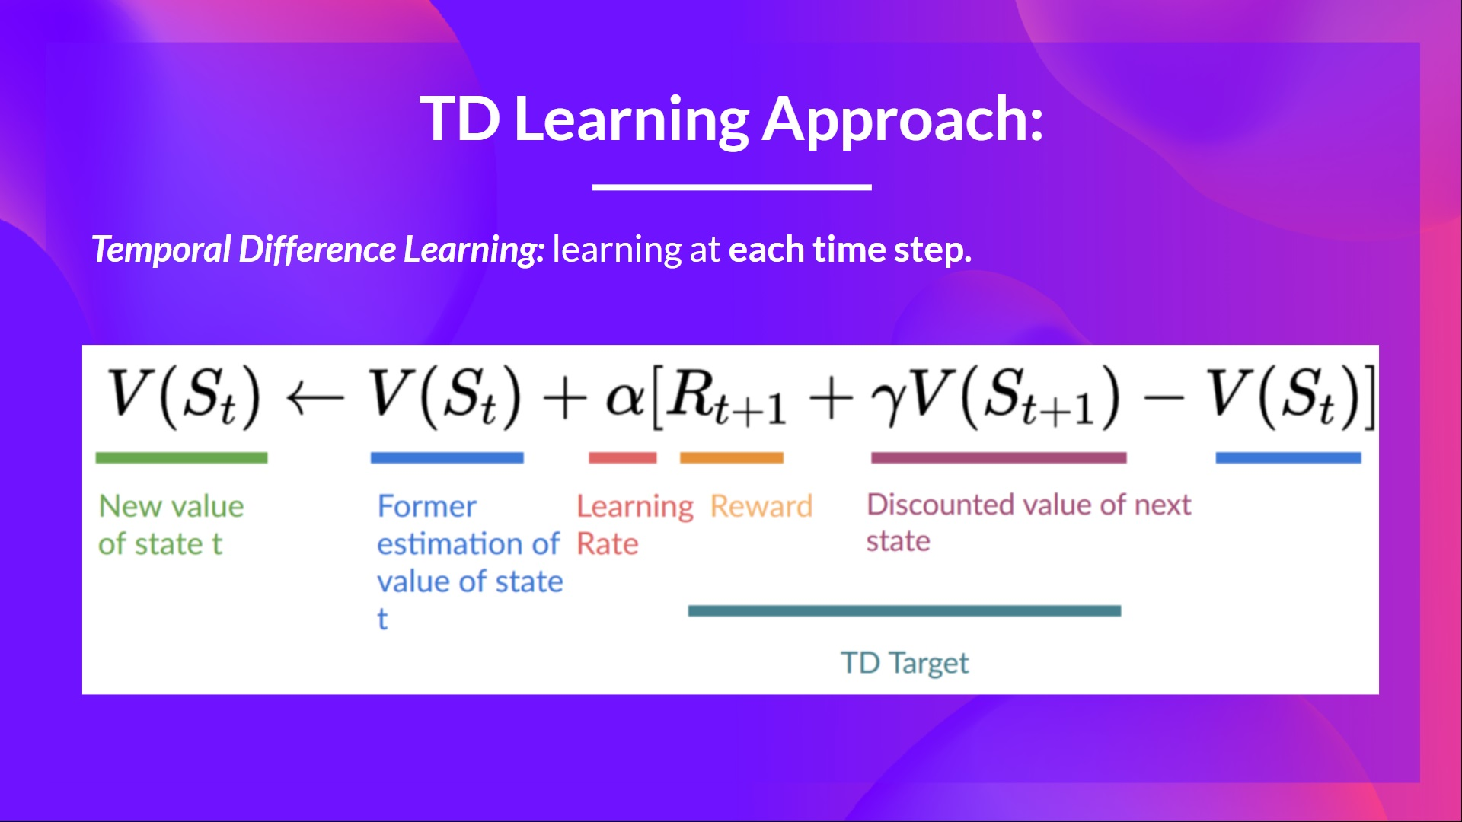
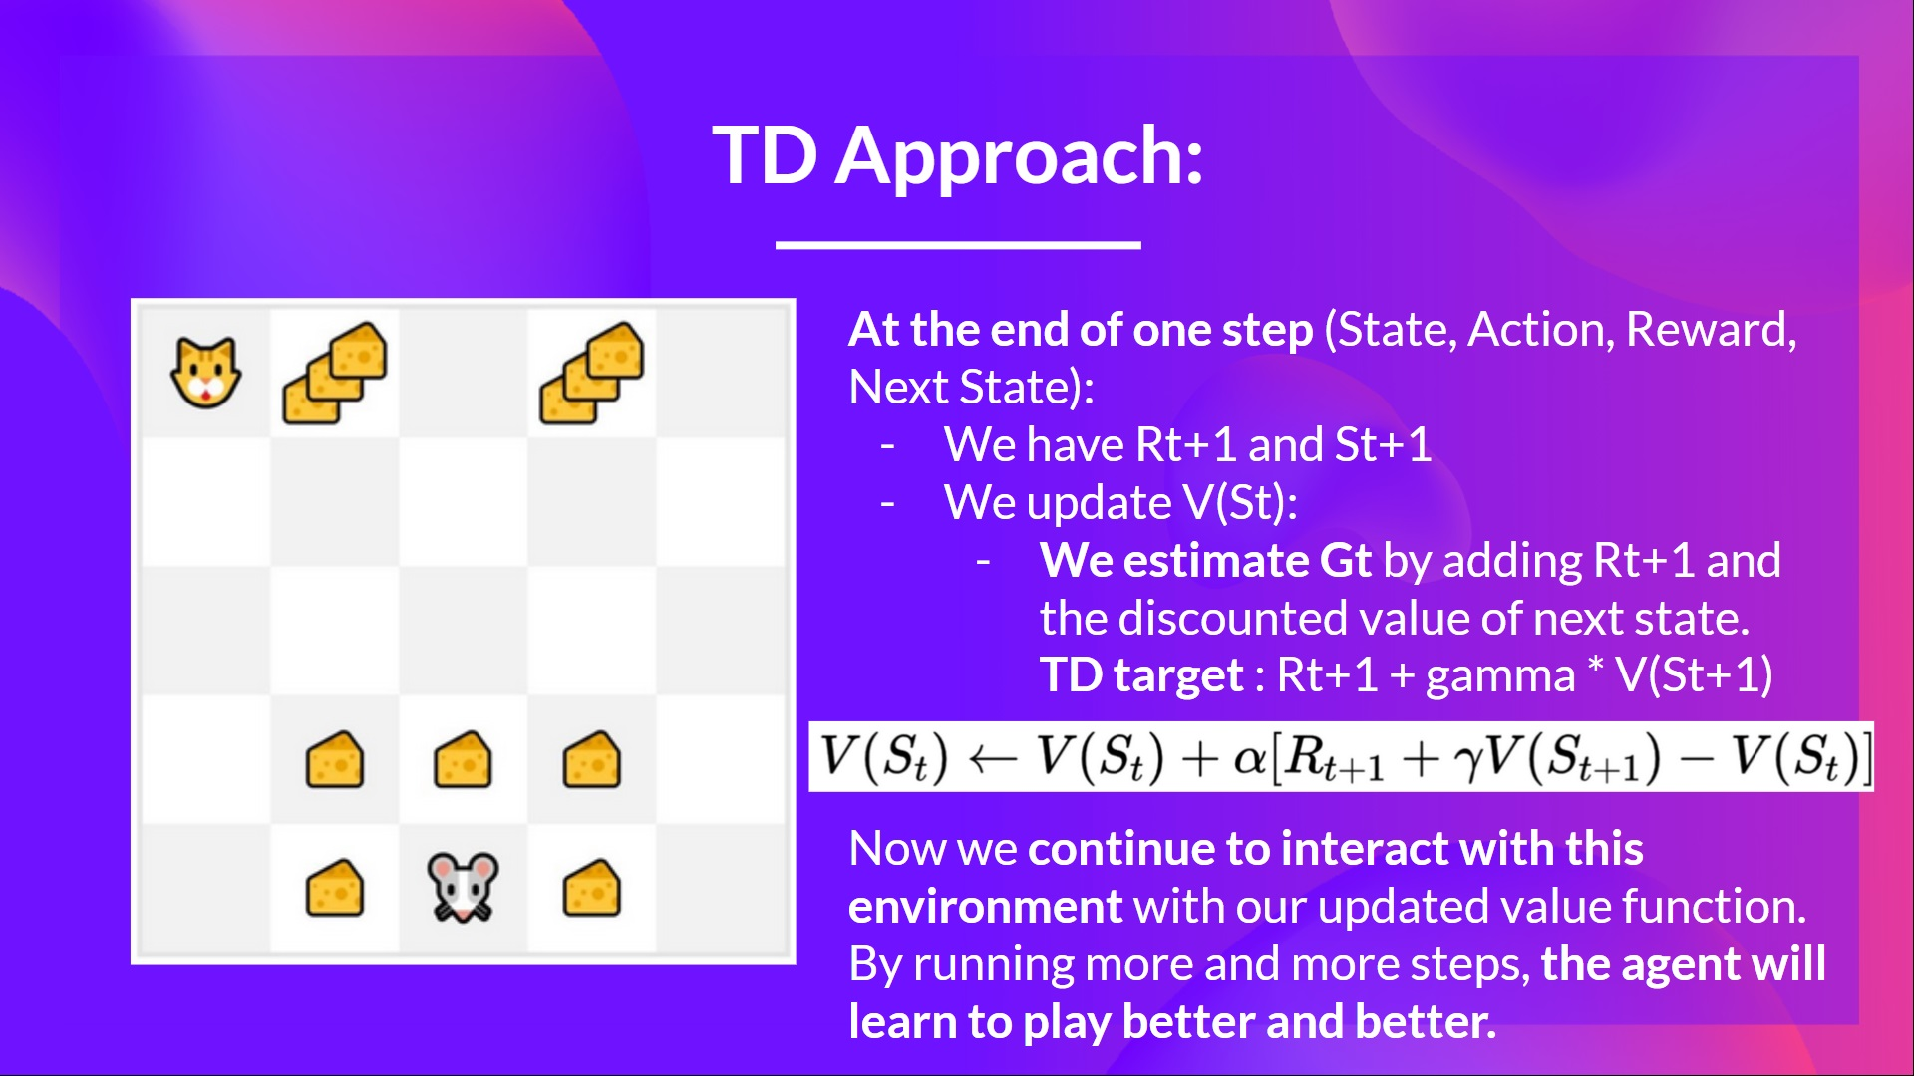
Refresher
INTRODUCTION TO COMPUTING
Course Code: CCINCOM/L
Joseph Marvin R. Imperial
REINFORCEMENT LEARNING
NU College of Computing and Information Technologies
Course Code: CCRNFLRL

Slide 5
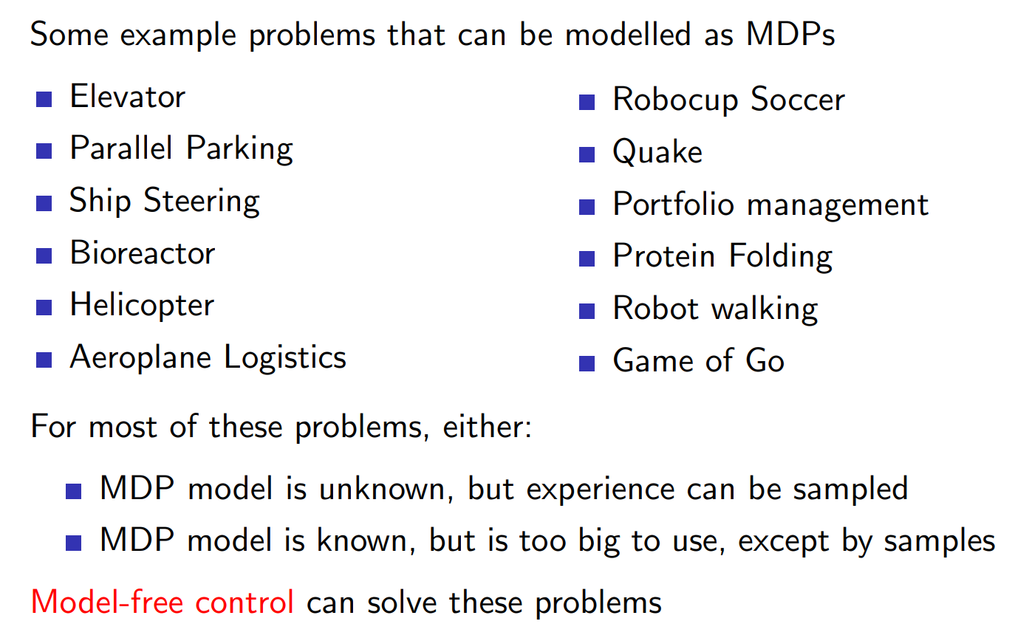
Uses of Model-Free Control
INTRODUCTION TO COMPUTING
Course Code: CCINCOM/L
Joseph Marvin R. Imperial
REINFORCEMENT LEARNING
NU College of Computing and Information Technologies
Course Code: CCRNFLRL

Slide 6
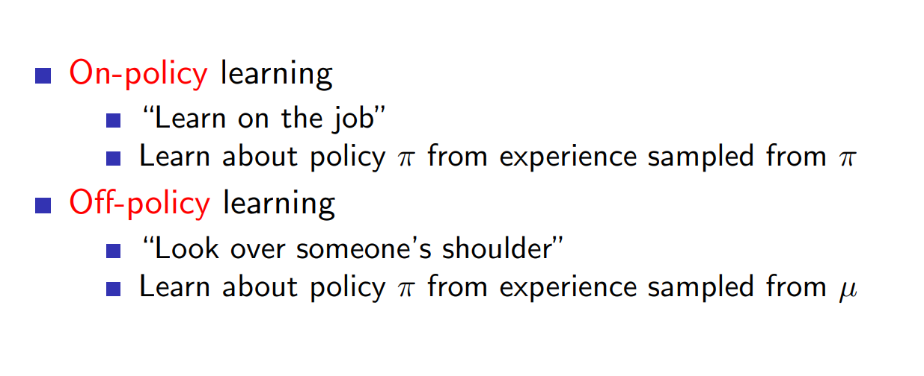
On-Policy and Off-Policy
INTRODUCTION TO COMPUTING
Course Code: CCINCOM/L
Joseph Marvin R. Imperial
REINFORCEMENT LEARNING
NU College of Computing and Information Technologies
Course Code: CCRNFLRL

Slide 7
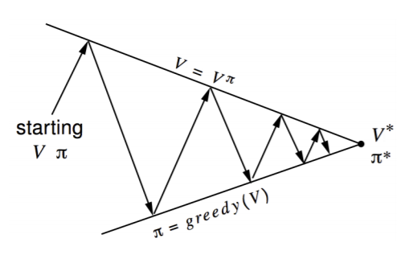
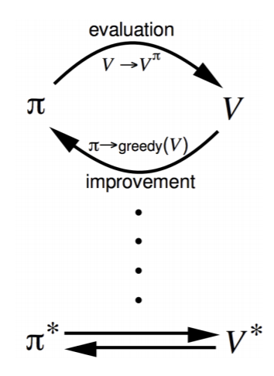
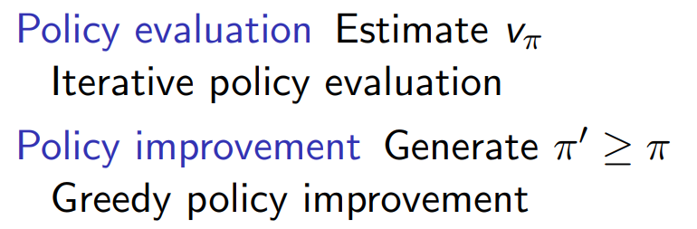
Policy Iteration (Refresher)
INTRODUCTION TO COMPUTING
Course Code: CCINCOM/L
Joseph Marvin R. Imperial
REINFORCEMENT LEARNING
NU College of Computing and Information Technologies
Course Code: CCRNFLRL

Slide 8
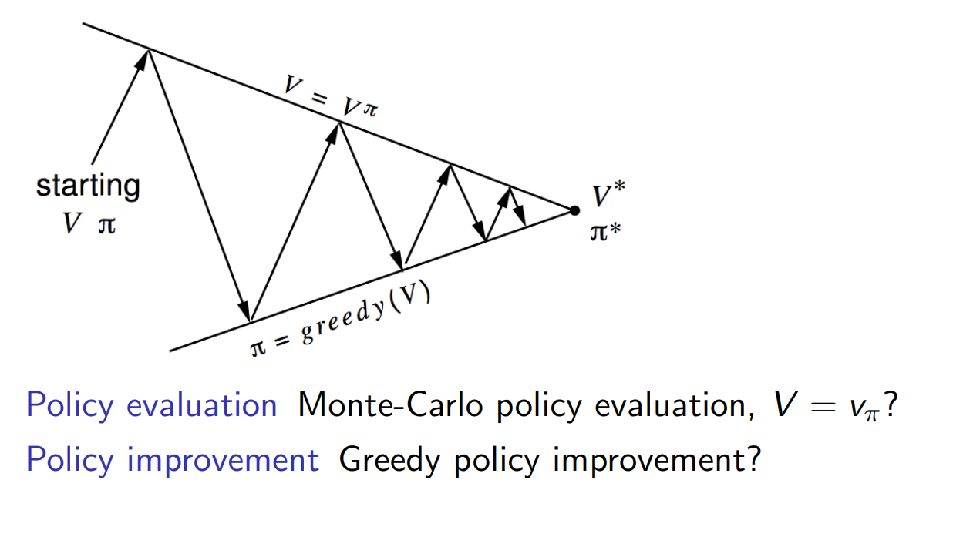
Policy Iteration with Monte-Carlo
INTRODUCTION TO COMPUTING
Course Code: CCINCOM/L
Joseph Marvin R. Imperial
REINFORCEMENT LEARNING
NU College of Computing and Information Technologies
Course Code: CCRNFLRL

Slide 9
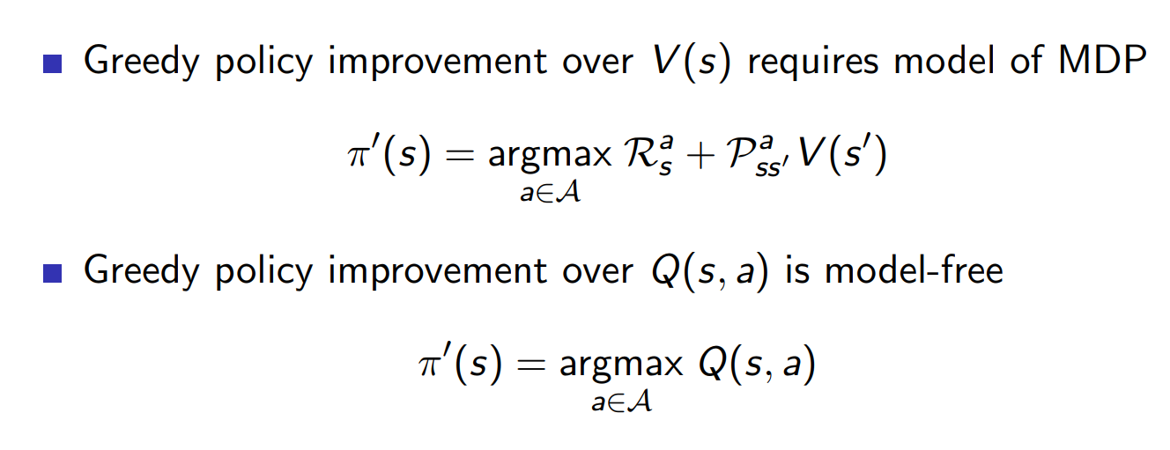

Model Free Policy Iteration using Action-Value Function
INTRODUCTION TO COMPUTING
Course Code: CCINCOM/L
Joseph Marvin R. Imperial
REINFORCEMENT LEARNING
NU College of Computing and Information Technologies
Course Code: CCRNFLRL

Slide 10
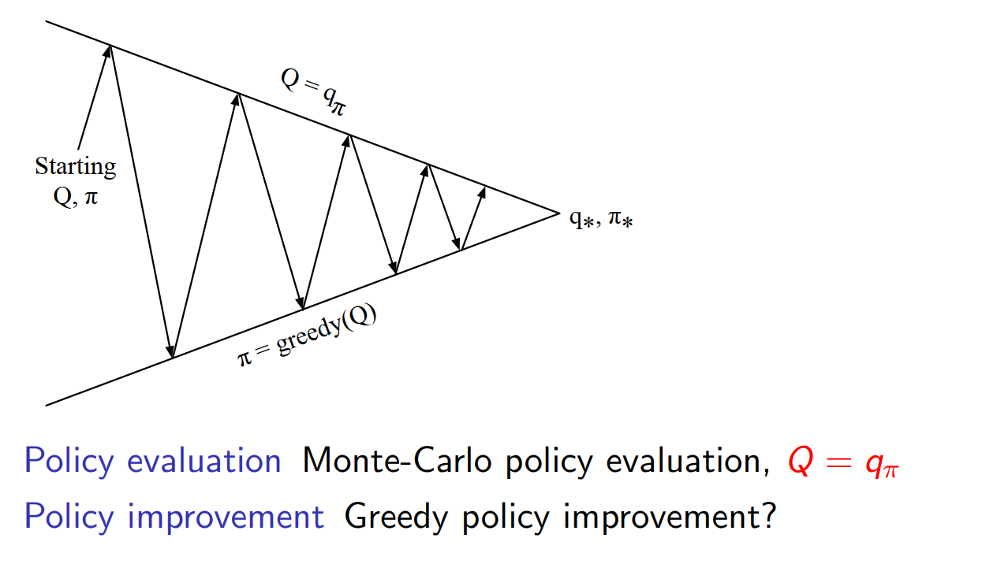

Policy Iteration using Action-Value Function
INTRODUCTION TO COMPUTING
Course Code: CCINCOM/L
Joseph Marvin R. Imperial
REINFORCEMENT LEARNING
NU College of Computing and Information Technologies
Course Code: CCRNFLRL

Slide 11
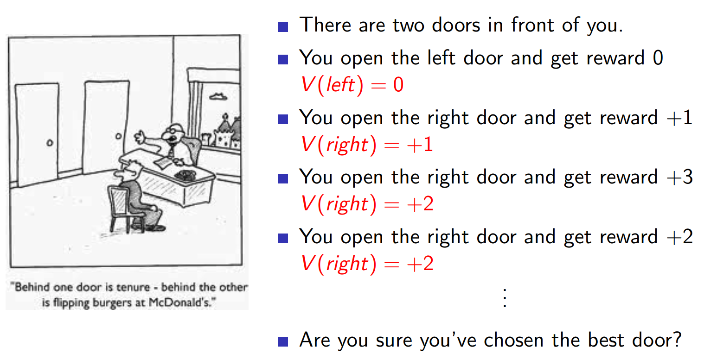
Greedy Action Selection
INTRODUCTION TO COMPUTING
Course Code: CCINCOM/L
Joseph Marvin R. Imperial
REINFORCEMENT LEARNING
NU College of Computing and Information Technologies
Course Code: CCRNFLRL

Slide 12
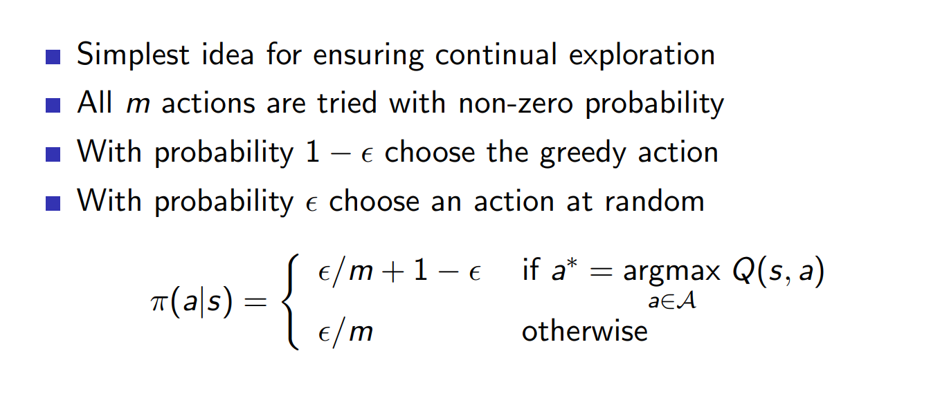
ε-Greedy Action Selection
INTRODUCTION TO COMPUTING
Course Code: CCINCOM/L
Joseph Marvin R. Imperial
REINFORCEMENT LEARNING
NU College of Computing and Information Technologies
Course Code: CCRNFLRL

Slide 13
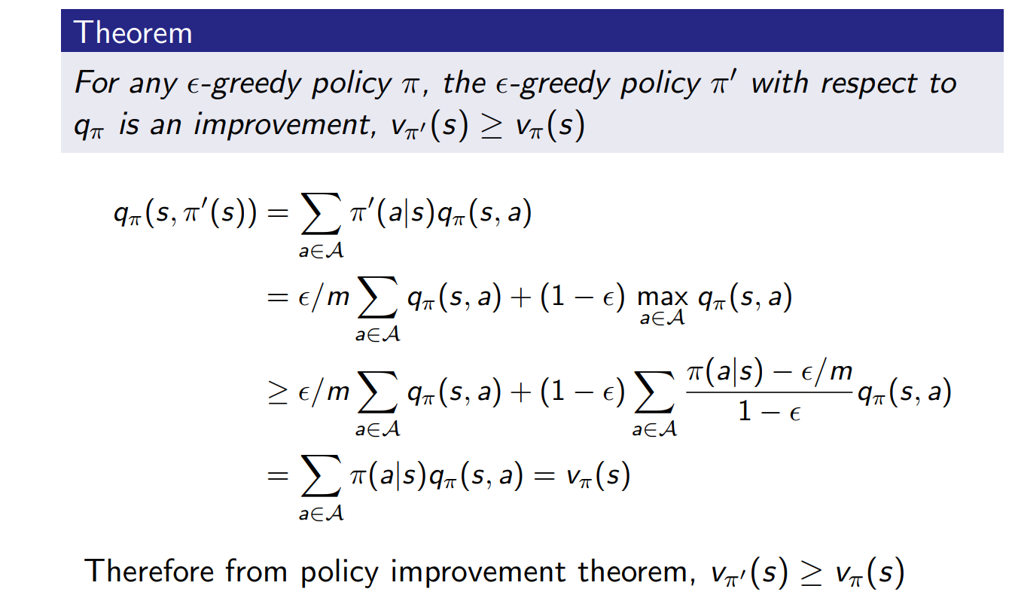

ε-Greedy Policy Improvement
INTRODUCTION TO COMPUTING
Course Code: CCINCOM/L
Joseph Marvin R. Imperial
REINFORCEMENT LEARNING
NU College of Computing and Information Technologies
Course Code: CCRNFLRL

Slide 14
Outline
INTRODUCTION TO COMPUTING
Course Code: CCINCOM/L
Introduction
On-Policy and Off-Policy
ε-Greedy Exploration
On-Policy
GLIE Monte-Carlo
SARSA
Off-Policy
Q-Learning
Joseph Marvin R. Imperial
REINFORCEMENT LEARNING
NU College of Computing and Information Technologies
Course Code: CCRNFLRL

Slide 15
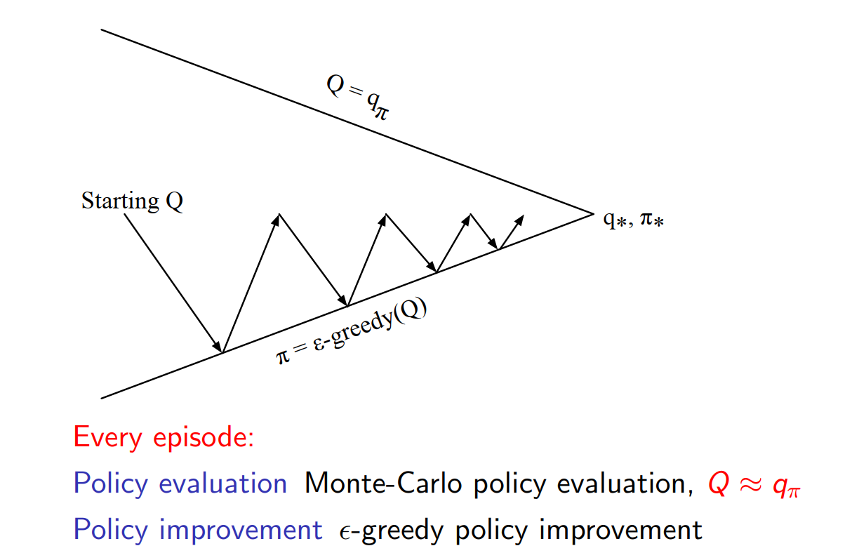
Monte-Carlo Control
INTRODUCTION TO COMPUTING
Course Code: CCINCOM/L
Joseph Marvin R. Imperial
REINFORCEMENT LEARNING
NU College of Computing and Information Technologies
Course Code: CCRNFLRL

Slide 16
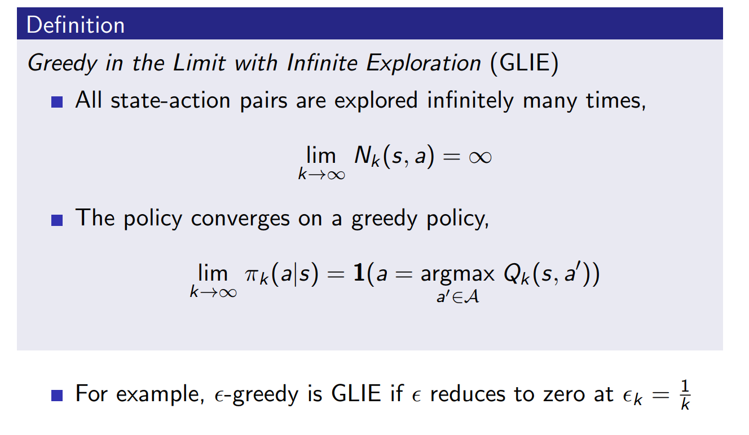

GLIE
INTRODUCTION TO COMPUTING
Course Code: CCINCOM/L
Joseph Marvin R. Imperial
REINFORCEMENT LEARNING
NU College of Computing and Information Technologies
Course Code: CCRNFLRL

Slide 17
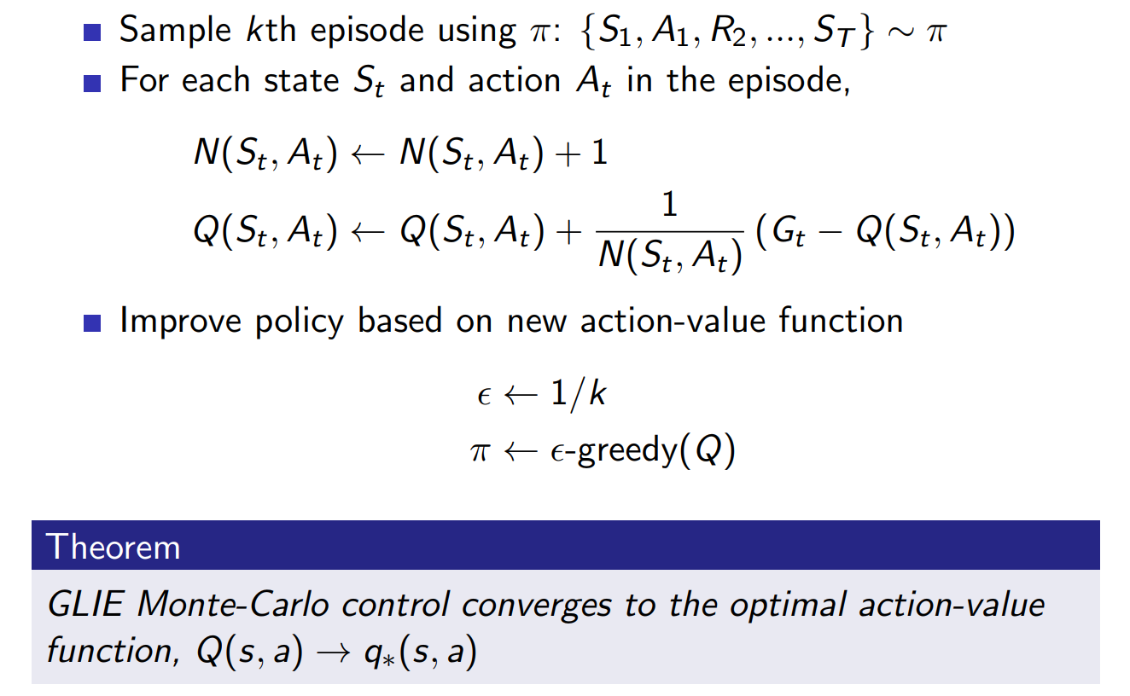
GLIE Monte Carlo Control
INTRODUCTION TO COMPUTING
Course Code: CCINCOM/L
Joseph Marvin R. Imperial
REINFORCEMENT LEARNING
NU College of Computing and Information Technologies
Course Code: CCRNFLRL

Slide 18
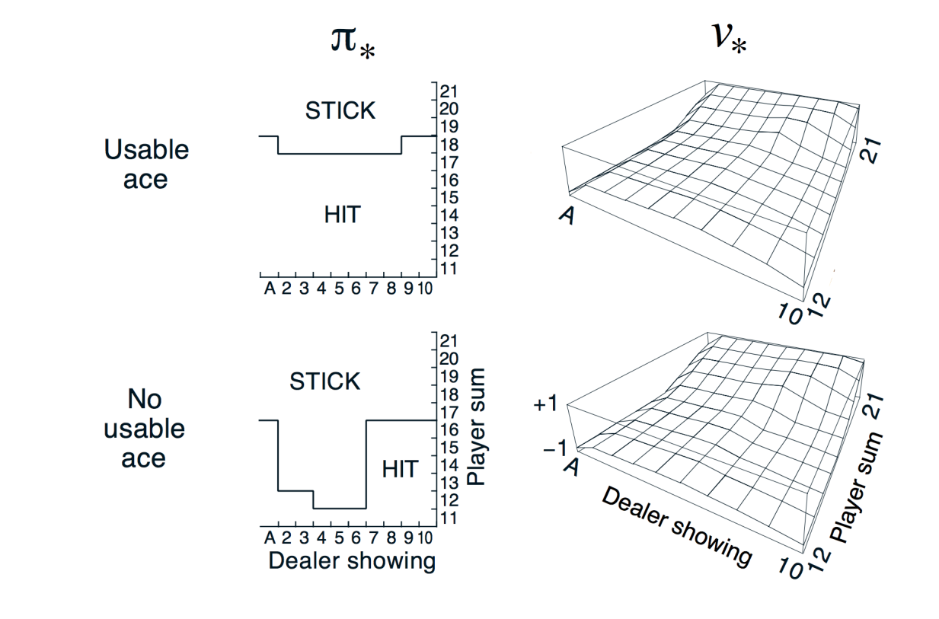

Monte Carlo Control in Blackjack
INTRODUCTION TO COMPUTING
Course Code: CCINCOM/L
Joseph Marvin R. Imperial
REINFORCEMENT LEARNING
NU College of Computing and Information Technologies
Course Code: CCRNFLRL

Slide 19
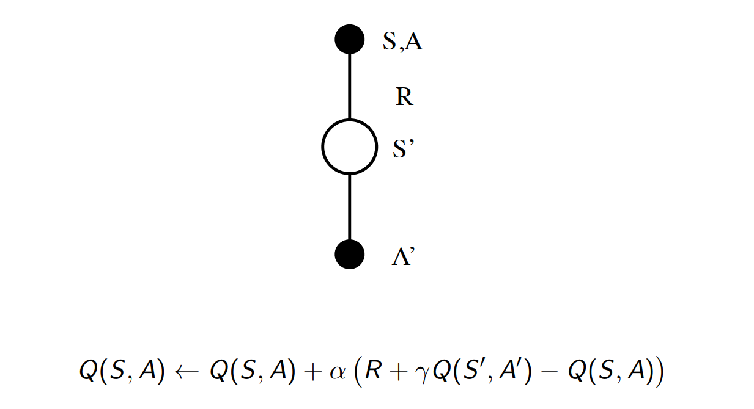

SARSA
INTRODUCTION TO COMPUTING
Course Code: CCINCOM/L
Joseph Marvin R. Imperial
REINFORCEMENT LEARNING
NU College of Computing and Information Technologies
Course Code: CCRNFLRL

Slide 20
SARSA
INTRODUCTION TO COMPUTING
Course Code: CCINCOM/L
is an on-policy algorithm where, in the current state, S, an action, A, is taken and the agent gets a reward, R, and ends up in the next state, S1, and takes action, A1, in S1, or in other words, the tuple S, A, R, S1, A1.
Joseph Marvin R. Imperial
REINFORCEMENT LEARNING
NU College of Computing and Information Technologies
Course Code: CCRNFLRL

Slide 21

SARSA
INTRODUCTION TO COMPUTING
Course Code: CCINCOM/L
Initialize the action-value estimates Q(s, a) to some arbitrary values.
Set the initial state s.
Choose the initial action a using an epsilon-greedy policy based on the current Q values.
Take the action a and observe the reward r and the next state s’.
Choose the next action a’ using an epsilon-greedy policy based on the updated Q values.
Update the action-value estimate for the current state-action pair using the SARSA update rule:
Q(s, a) = Q(s, a) + alpha * (r + gamma * Q(s’, a’) – Q(s, a))
Joseph Marvin R. Imperial
REINFORCEMENT LEARNING
NU College of Computing and Information Technologies
Course Code: CCRNFLRL

Slide 22
Outline
INTRODUCTION TO COMPUTING
Course Code: CCINCOM/L
Introduction
On-Policy and Off-Policy
ε-Greedy Exploration
On-Policy
GLIE Monte-Carlo
SARSA
Off-Policy
Q-Learning
Joseph Marvin R. Imperial
REINFORCEMENT LEARNING
NU College of Computing and Information Technologies
Course Code: CCRNFLRL

Slide 23
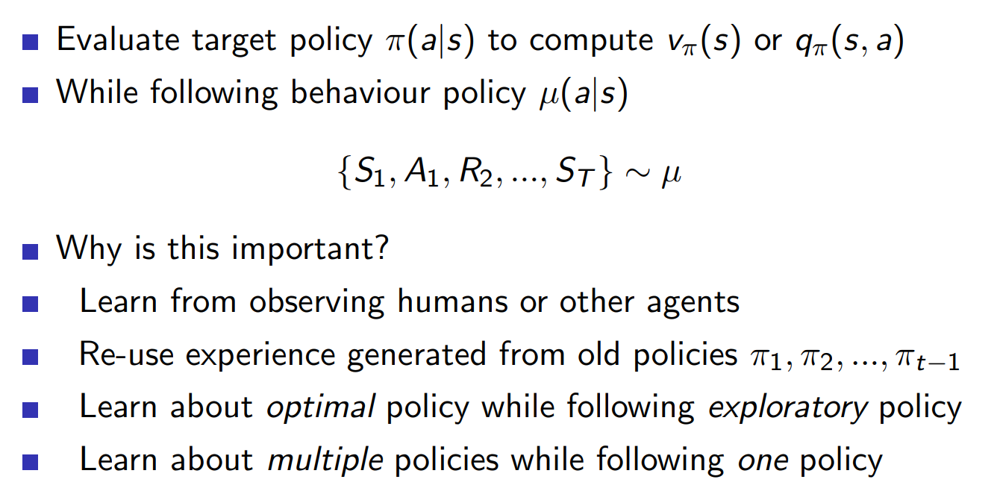
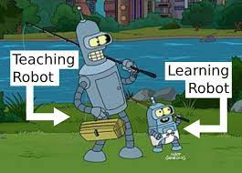

Off-Policy Learning
INTRODUCTION TO COMPUTING
Course Code: CCINCOM/L
Joseph Marvin R. Imperial
REINFORCEMENT LEARNING
NU College of Computing and Information Technologies
Course Code: CCRNFLRL

Slide 24
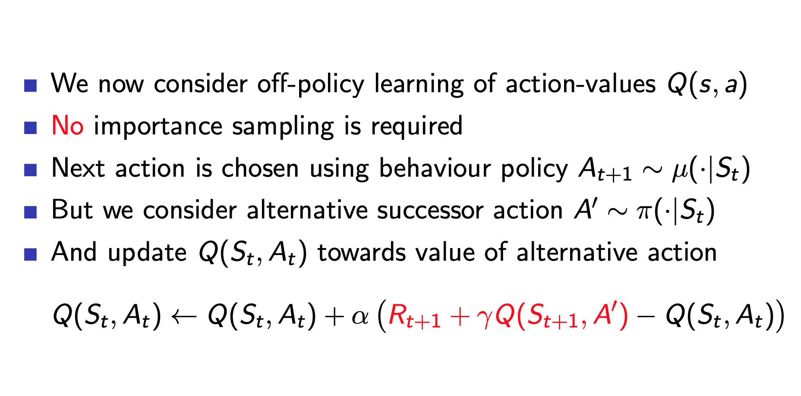
Q-Learning
INTRODUCTION TO COMPUTING
Course Code: CCINCOM/L
Joseph Marvin R. Imperial
REINFORCEMENT LEARNING
NU College of Computing and Information Technologies
Course Code: CCRNFLRL

Slide 25
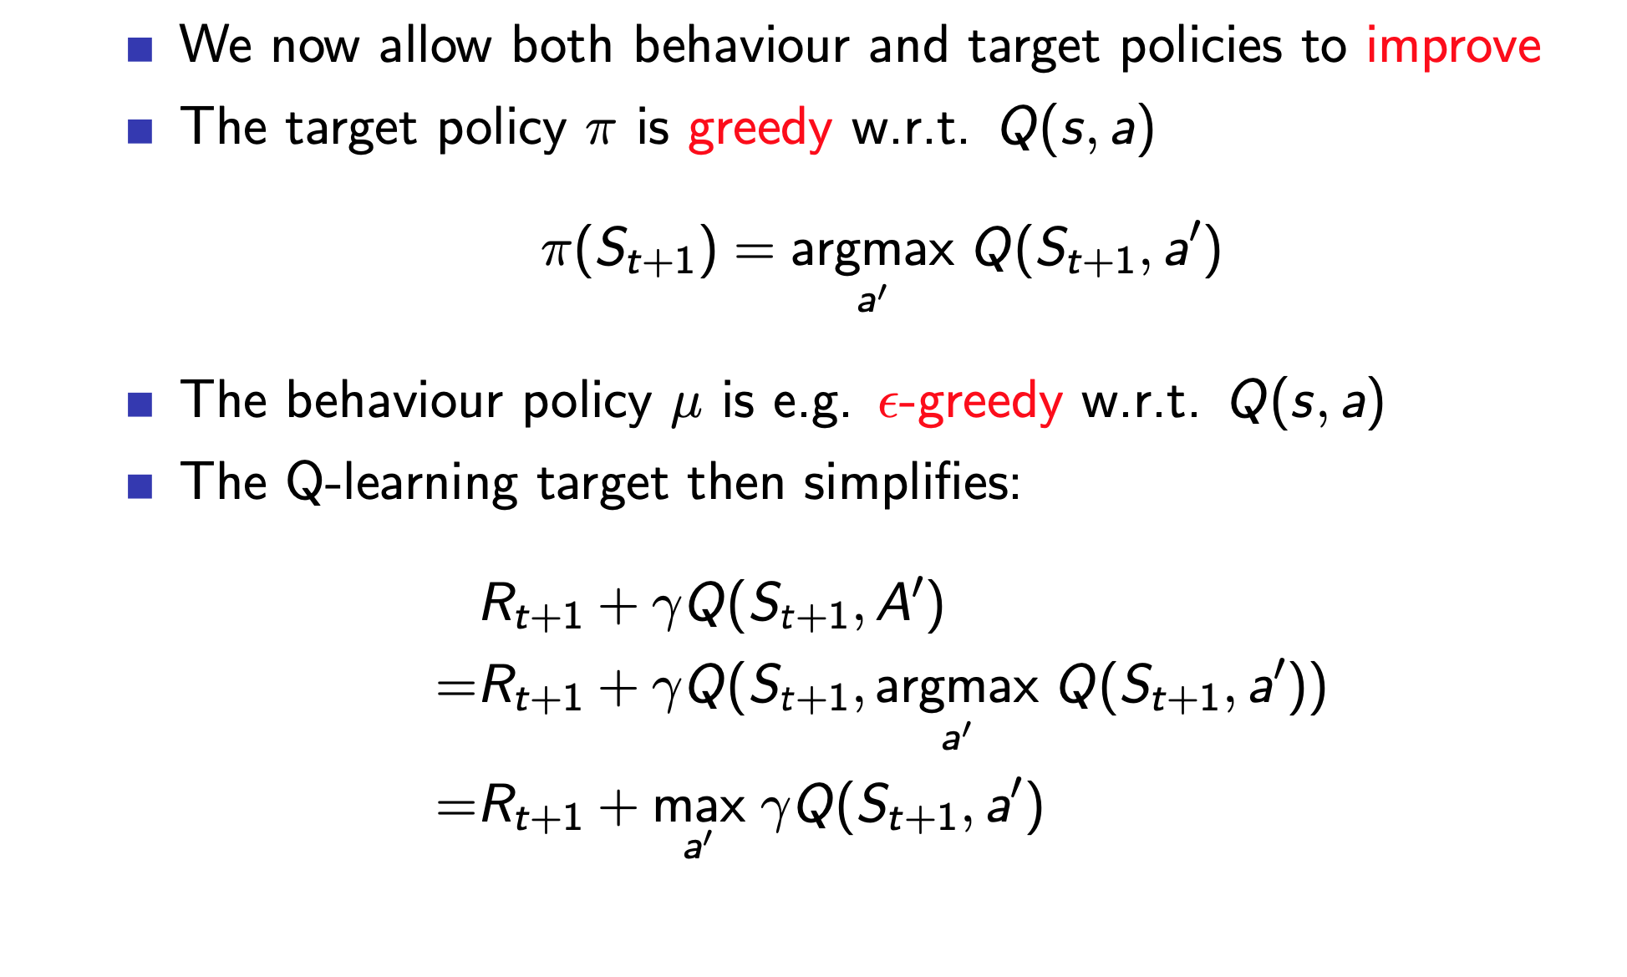

Q-Learning
INTRODUCTION TO COMPUTING
Course Code: CCINCOM/L
Joseph Marvin R. Imperial
REINFORCEMENT LEARNING
NU College of Computing and Information Technologies
Course Code: CCRNFLRL

Slide 26
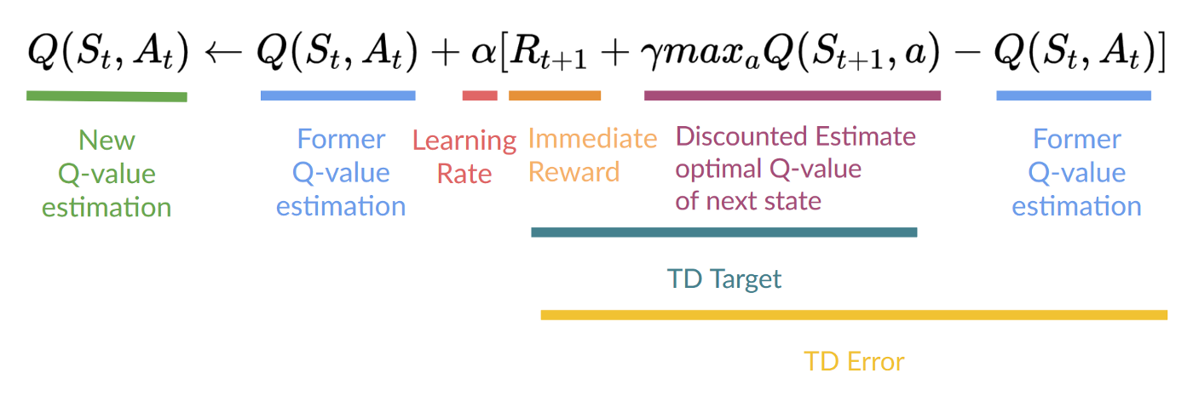

Q-Learning
INTRODUCTION TO COMPUTING
Course Code: CCINCOM/L
Joseph Marvin R. Imperial
REINFORCEMENT LEARNING
NU College of Computing and Information Technologies
Course Code: CCRNFLRL

Slide 27
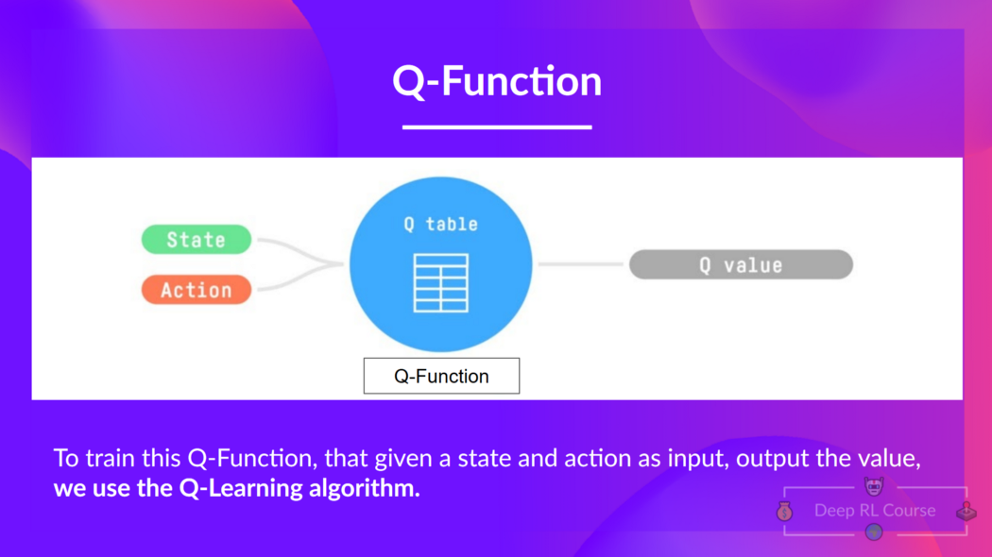
Q-Learning
INTRODUCTION TO COMPUTING
Course Code: CCINCOM/L
Joseph Marvin R. Imperial
REINFORCEMENT LEARNING
NU College of Computing and Information Technologies
Course Code: CCRNFLRL

Slide 28
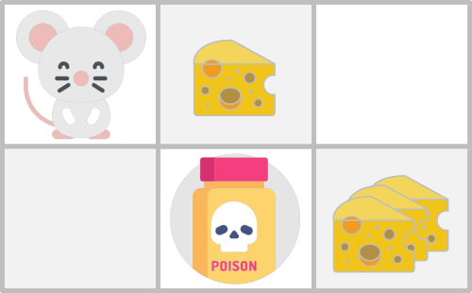

Q-Learning
INTRODUCTION TO COMPUTING
Course Code: CCINCOM/L
Joseph Marvin R. Imperial
REINFORCEMENT LEARNING
NU College of Computing and Information Technologies
Course Code: CCRNFLRL

Slide 29
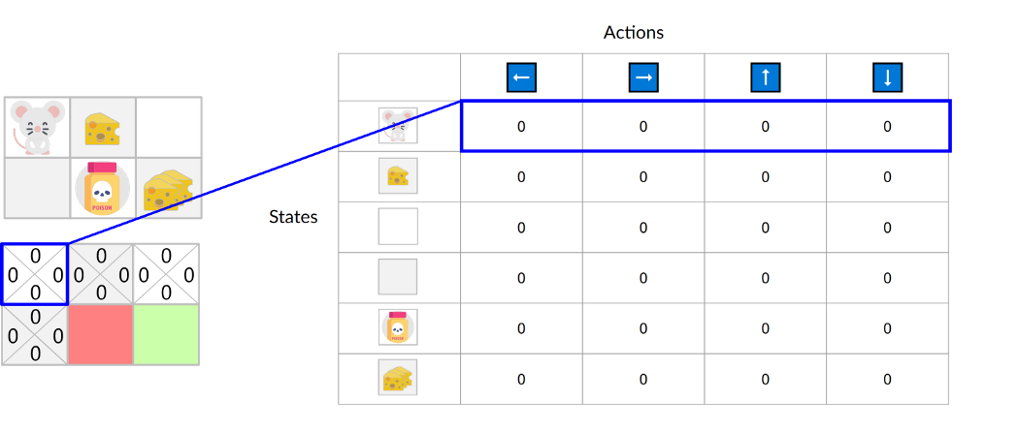

Q-Learning
INTRODUCTION TO COMPUTING
Course Code: CCINCOM/L
Joseph Marvin R. Imperial
REINFORCEMENT LEARNING
NU College of Computing and Information Technologies
Course Code: CCRNFLRL

Slide 30
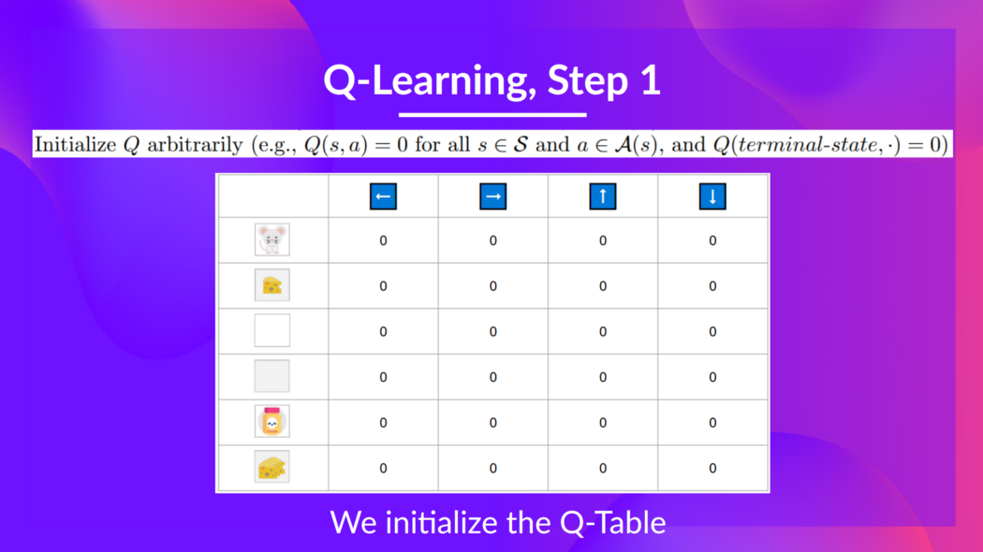

Q-Learning
INTRODUCTION TO COMPUTING
Course Code: CCINCOM/L
Joseph Marvin R. Imperial
REINFORCEMENT LEARNING
NU College of Computing and Information Technologies
Course Code: CCRNFLRL

Slide 31
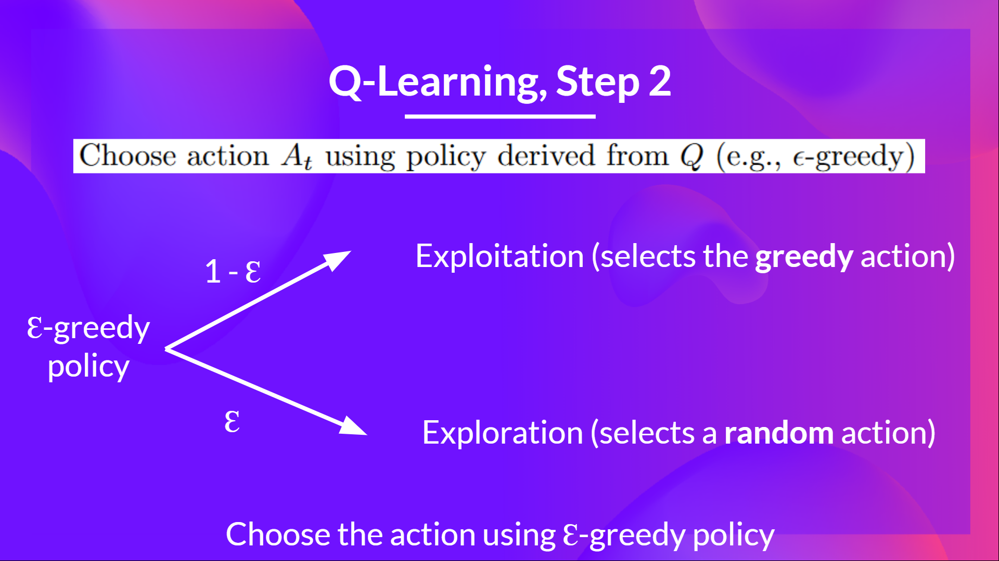

Q-Learning
INTRODUCTION TO COMPUTING
Course Code: CCINCOM/L
Joseph Marvin R. Imperial
REINFORCEMENT LEARNING
NU College of Computing and Information Technologies
Course Code: CCRNFLRL

Slide 32

Q-Learning
INTRODUCTION TO COMPUTING
Course Code: CCINCOM/L
Joseph Marvin R. Imperial
REINFORCEMENT LEARNING
NU College of Computing and Information Technologies
Course Code: CCRNFLRL

Slide 33
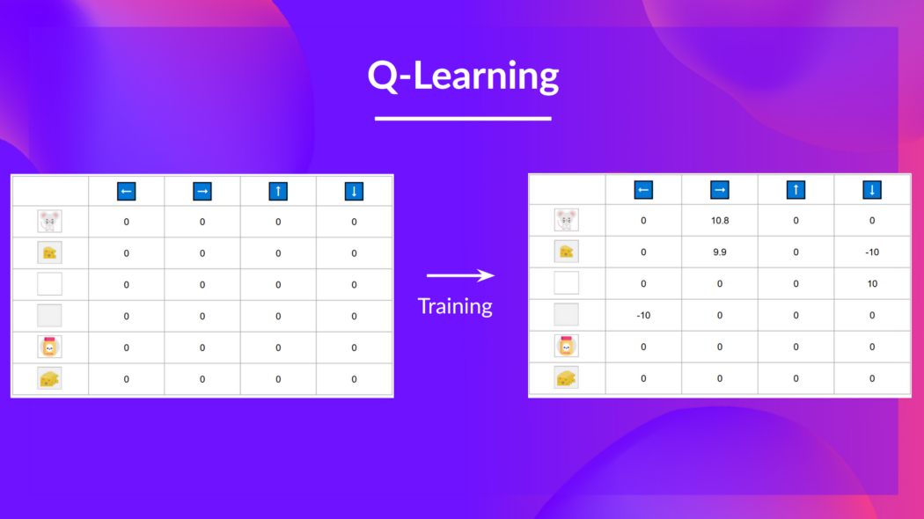

Q-Learning
INTRODUCTION TO COMPUTING
Course Code: CCINCOM/L
Joseph Marvin R. Imperial
REINFORCEMENT LEARNING
NU College of Computing and Information Technologies
Course Code: CCRNFLRL

Slide 34
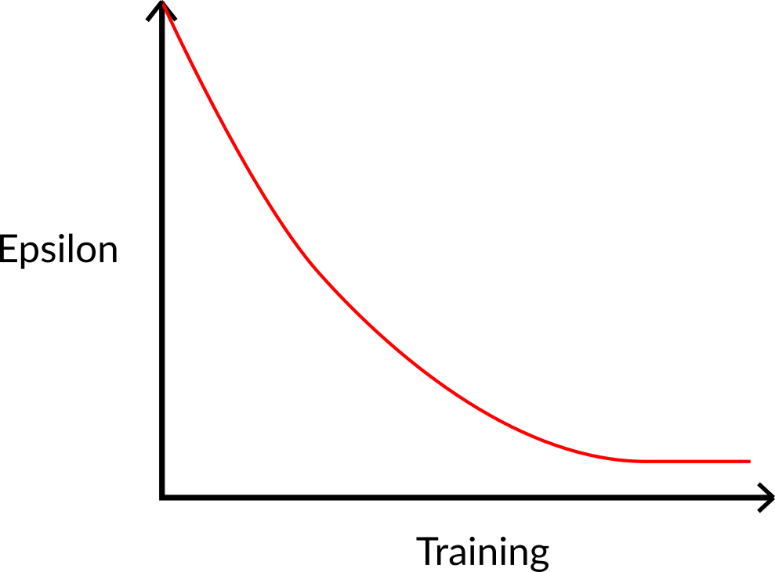

Q-Learning
INTRODUCTION TO COMPUTING
Course Code: CCINCOM/L
Joseph Marvin R. Imperial
REINFORCEMENT LEARNING
NU College of Computing and Information Technologies
Course Code: CCRNFLRL

Slide 35
References
INTRODUCTION TO COMPUTING
Course Code: CCINCOM/L
Images are licensed with Creative Commons. Can use without citing.
Prof. Emma Brunskill’s slides (CS234RL). https://web.stanford.edu/class/cs234/slides/lecture1.pdf
David Silver’s slides. https://www.davidsilver.uk/wp-content/uploads/2020/03/intro_RL.pdf
Review in Probability, Intro to RL Concepts
Joseph Marvin R. Imperial
REINFORCEMENT LEARNING
NU College of Computing and Information Technologies
Course Code: CCRNFLRL

